Slide 1

REINFORCEMENT LEARNING
06 May 2024 , Monday
Deep Reinforcement Learning for Atari Breakout
By - Kaustubh Raykar - 21070126048
Srinivas Kota - 21070126050
Faculty - Smita Mahajan Ma’am
Rahee Walambe Ma’am

Slide 2


Group Members
Kaustubh Raykar
Srinivas Kota
21070126048
21070126050

Slide 3
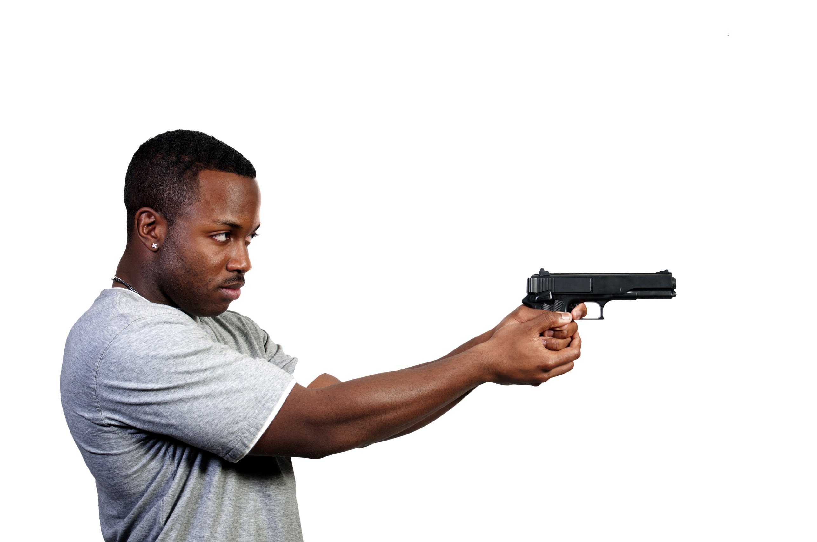
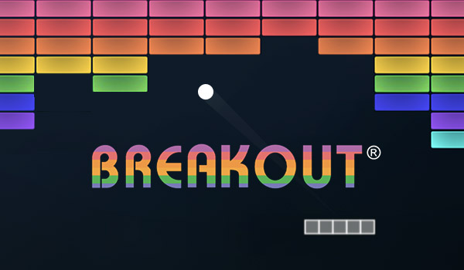
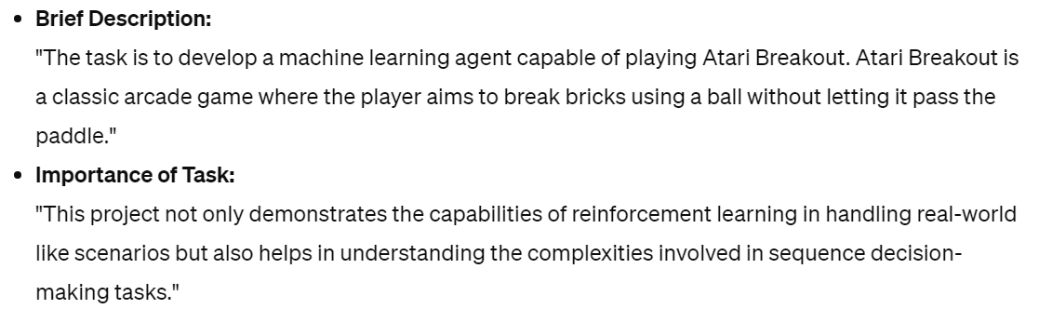
Problem Statement

Slide 4
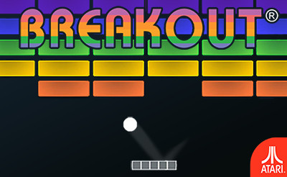

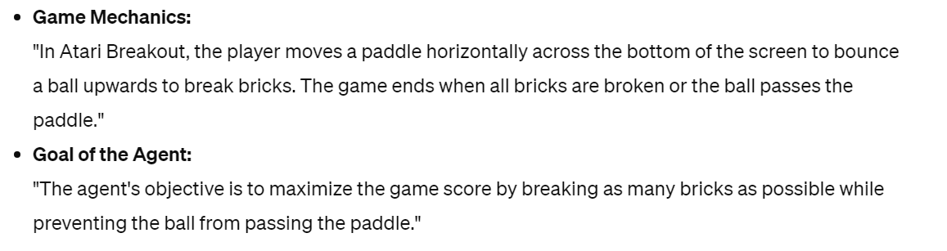
Game Overview

Slide 5
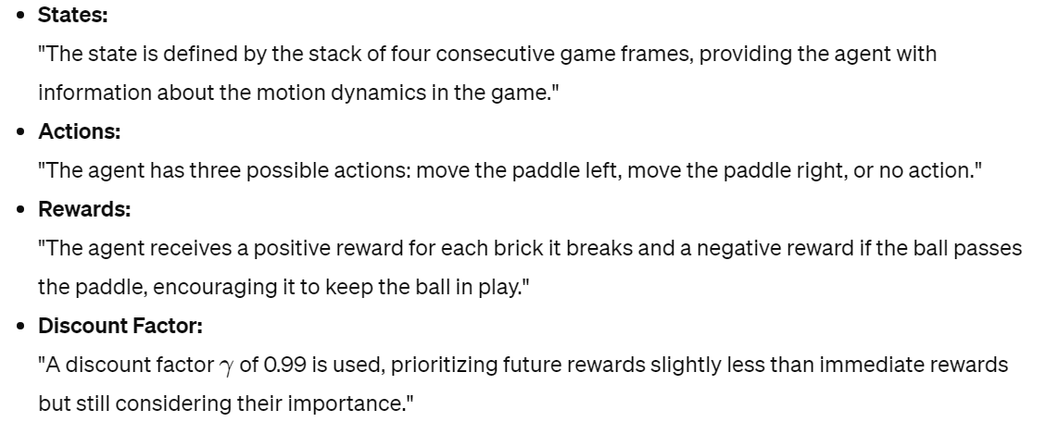
Markov Decision Process (MDP) Formulation

Slide 6
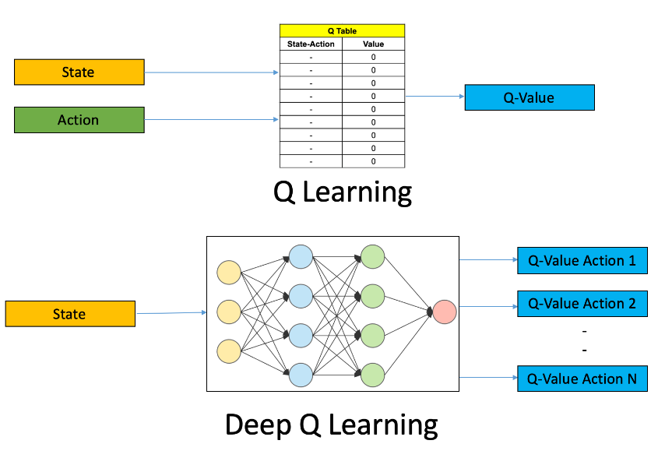
Deep Q-Network Model

Slide 7
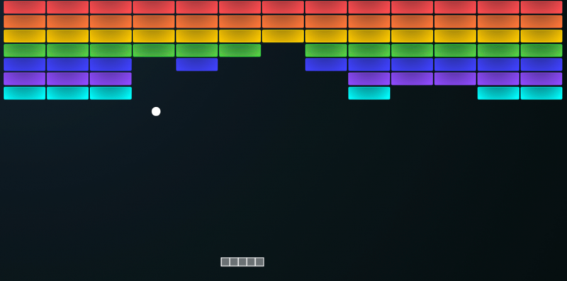
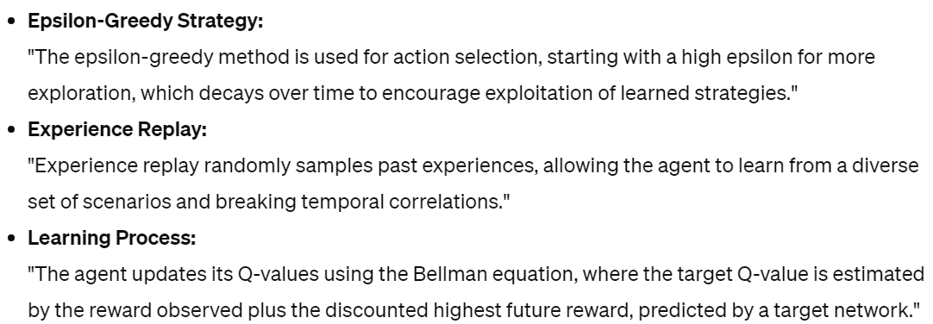
Method Description

Slide 8
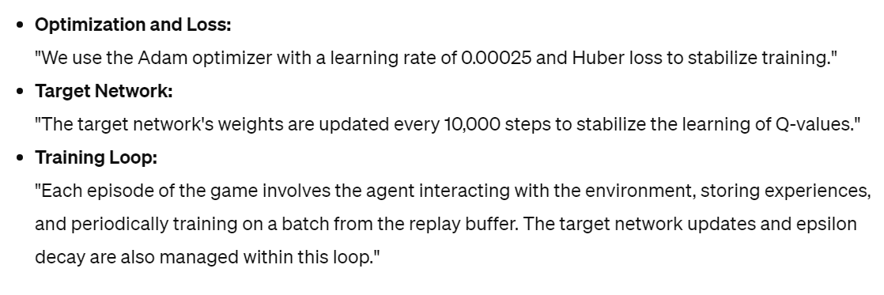
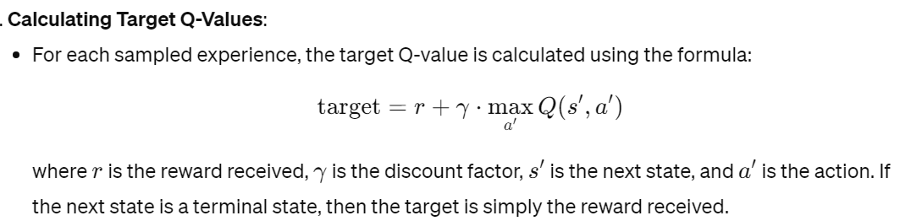
Training Details

Slide 9
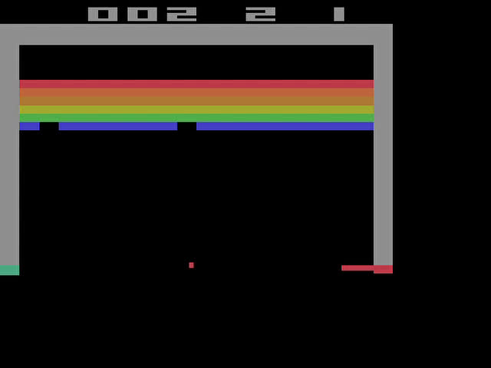
THE GAME

Slide 10
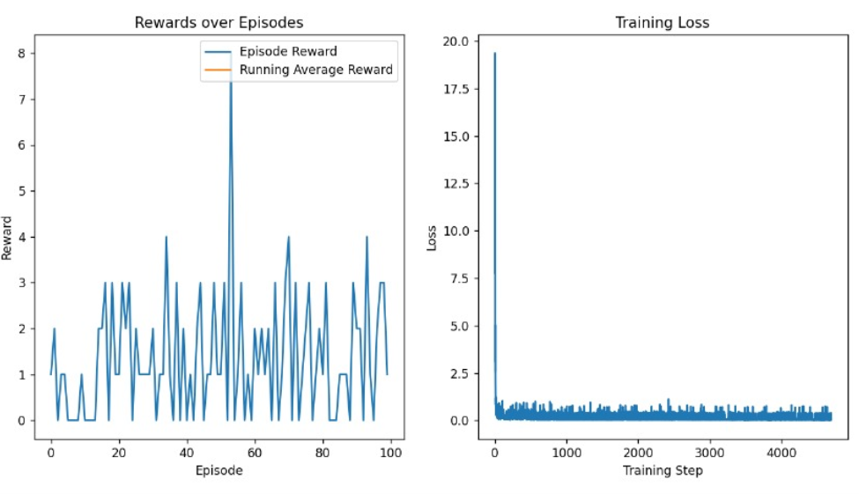
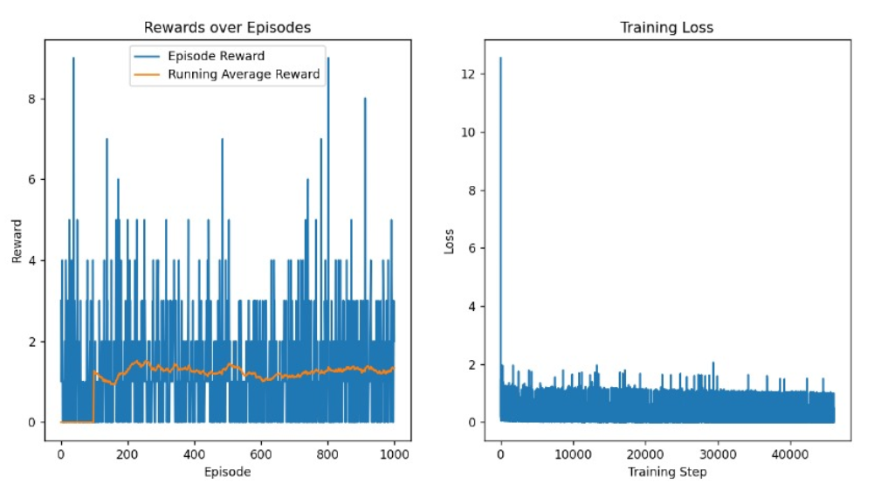
GRAPHS

Slide 11
COMPUTER VISION
23 April 2024 , Friday
Thank you!

